Slide 1
HMI - Web Visualization
Initializing CoDeSys WEB Visualization
Creating Visualization Objects
Creating TABS for Paging
Loading a WEB Visualization Page Into a Browser
Notes:
Start @ 8:15

Slide 2
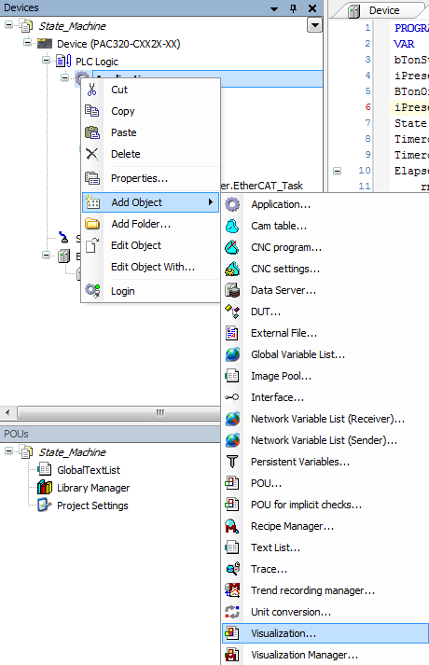
WEB Visualization - Setup
Setting up a Simple Visualization Page
Right Click on the Application, Left Click on “Add Object” Then “Visualization”
An Add Visualization Popup will appear. Name it “TAB” and click on <Add>
Clicking on “Visualization”, creates a Visualization Page, the Web Visualization Manager and Webvisualization Properties page along with the Visualization tasks.
The Page we Named “TAB” will be used to hold multiple visualization pages, that can be tabbed between

Slide 3
WEB Visualization - Setup
Now Add 2 more Visualization Pages Named “Control” and “Display_1”.
Use the same Procedure as we used to create TAB. When done it should look as below.
Double Click on “ WebVisualization”
Click on the Imput Assistant ICON and Select “TAB” for your “Start Visualization”,
Make Note of your .htm file Name, default “webvisu”
Notes:
Mention the Visualizations May be in a different order

Slide 4
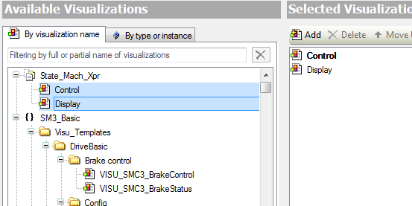
Visualization – TAB Visualization
TAB
ToolBox ➔Common Controls ➔Tab Control
Select Control & Display_1 then Click on <Add> then <OK>.

Slide 5
Visualization – TAB Visualization(Cont)
Size the TAB Element – The actual Visualization Tools will be created on the “Control” and “Display_1” POUs and will be echoed by the TAB Element.
You will See the Properties Box for TAB, Referencing “Control” & Display_1, Fill out the Headings as Shown.
By Clicking on <Configure> you can Add Additional Visualization Screens.
Scale Type – Recommended fixed

Slide 6
Visualization – Elements
From Lamps/Switches/Bitmaps
Dip Switch
Lamp
From Common Controls
Label
Text Box
From Measuremnt Controls
Bar Display
➔
Notes:
Clicking on Porperties Box then Pressing F1 will display Help specific to that properties Box

Slide 7
Timer Control Visualization

Slide 8
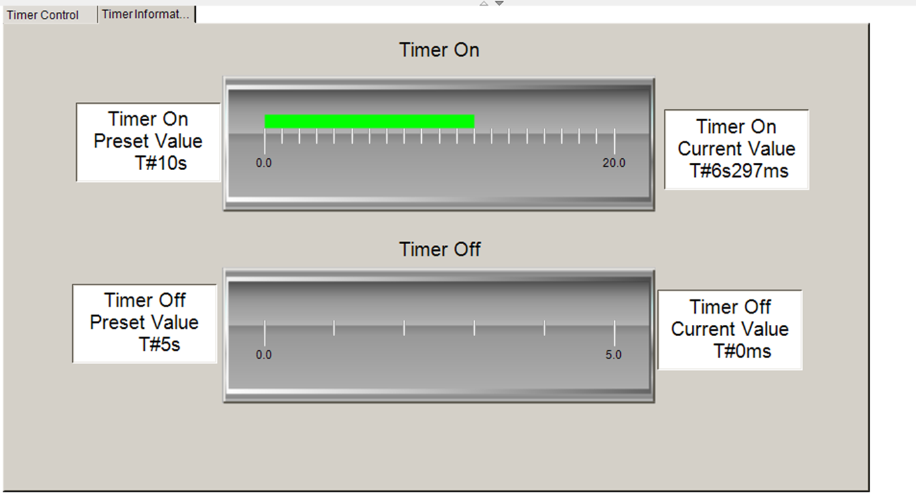
Timer Information Visualization

Slide 9
Visualization – Accessing over a Network or Interenet
Use the following URL:
http://PAC IP Address:8080/webvisu.htm, The webvisu.htm is from the WebVisualization Properties, “Name of .htm file:”
Default IP address used below.
http://192.168.10.50:8080/webvisu.htm

Slide 10
Need slide for exercise around creating web visu elements for axis control

Slide 11
Questions

